Slide 1
Outbreak Investigation Module: Mapping in R
Introduction to case study
Amy Mikhail
Friday 09 December 2022

Slide 2
Objectives / session structure
Creating geographic maps: what you need to know (refresher)
Example maps
Introduction to mapping case study

Slide 3
Mapping terminology refresher

Slide 4
Some key terminology: a refresher
CRS
Ellipse
Datum
Projection
EPSG

Slide 5
Terminology
CRS = Coordinate Reference System
Ellipse
Datum
Projection
Notes:
CRS stands for coordinate reference system
A CRS provides a standardized way of describing locations.
Many different CRS are used to describe geographic data.
A CRS is comprised of an ellipse, datum and projection

Slide 6


Terminology
Ellipse
Datum
Notes:
An ellipse describes the general shape of the earth; it is the first step in developing a CRS.
All mapping and coordinate systems are based on this shape.

Slide 7

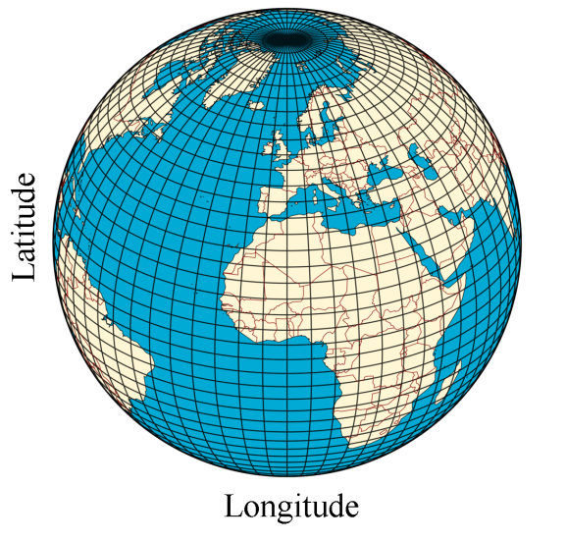

Terminology
+
=
Ellipse
Datum
3D Globe
Notes:
By combining an ellipse and the datum we get a 3D globe with latitude and longitude coordinates
We can then map directly onto this 3D globe using latitude and longitude

Slide 8
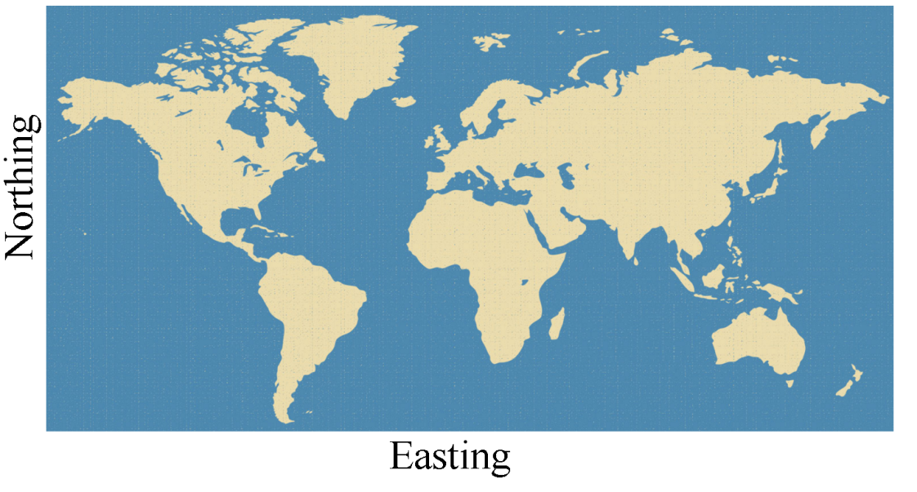
Terminology
3D Globe
2D map
Notes:
Alternatively we can project this 3D globe onto a 2D surface (called a map)
A projection is used to convert the 3D globe to a 2D map (this is done through a standard formula)
We can then use latitude and longitude to describe a point on a map
Note: there will always be some level of distortion when converting the 3D globe into a 2D map

Slide 9

Terminology
EPSG =
Notes:
EPSG is like a catalog for a coordiante system, where each coordinate system has a unique reference code

Slide 10



Terminology
WGS84 (EPSG: 4326)
OSGB 1936 (EPSG: 27700)
NAD27 (EPSG: 4267)
Notes:
Some examples of CRSs with corresponding ESPGs
WGS84 (latitude and longitude) is very common and used by google maps
OSBG 1936 is the ordinance survey national grid (eastings and northings) used in UK
NAD27 is also a common CRS used in the United States
Don’t worry too much about the details of all this but it is important to be aware of what CRS you are using, because if trying to combine data with different CRS you must transform them to a common CRS so they align with one another.
This is similar to making sure that units are the same when measuring distance.

Slide 11
Maps in R: some examples

Slide 12
Why map in R?
Repeatable
Link to data sources
Ability to annotate
Integration between visualisation and analysis
Convert between geographic reference types
Notes:
Repeatable:
-Great for routine reporting/sitreps as the steps to create a map are written in a script that can be run on new or updated data
-Also if you’ve write out the code to create a map it is easy to adapt this code to a different dataset (as we shall hopefully see in this practical)
Link to data sources:
Can bring in multiple data sources, for example:
connect to a surveillance database for counts of cases
connect to a population repository
overlay data to get rates and map rates directly onto a shape file
This is something you can’t do in STATA where you can only work with one data set as a time
Ability to annotate:
The ability to annotate is hugely beneficial as you are able to come back to a script months later and understand step-by-step what you did to create a map or conduct an analysis, whereas in other software such as QGIS or ArcGIS you have no idea how you have arrived at your final map.
Integration:
There are numerous options for further analysis, R is open source software with thousands of contributors; new data visualisation and analytical packages are being added all the time.
Any R user with sufficient knowledge of the language can create bespoke functions and packages to suit their needs.
tidygeocoder r package:
Postcodes or addresses can easily be converted to GPS coordinates or mapped to specific geographies for case management, such as a health region.
Create interactive maps:
- You can use packages like leaflet and shiny to create interactive maps

Slide 13
Challenges of mapping in R
Many different approaches & packages – need familiarity with R
Certain mapping tasks need connection to the internet:
Converting postcodes and addresses to a suitable CRS
Defining the edges of your map
Importing static background map tiles
Importing shape files (unless stored locally)
Notes:
Use R:
Using R script to create maps can involve lots of coding to fine-tune the look of the map; need to be familiar with R language to manipulate it and understand the appropriate data input formats
Not interactive while creating the map:
You can’t navigate as you can in ArcGIS, zooming in and highlighting particular geographies/points
Shape file import:
You need shape files on local machine, this is not too big an issue as you can simply export from ArcGIS and only need to do once but is a little annoying

Slide 14
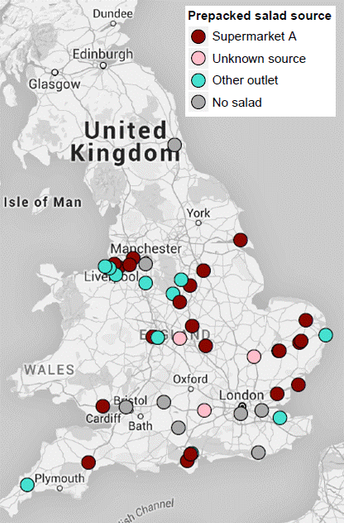
Example 1: static point map of cases
Map outbreak cases
No need for shape file
Can overlay points on OpenStreetMap
Access to map options via ggmap
Map is secure (on your local machine)
Can stratify by exposure etc.

Slide 15
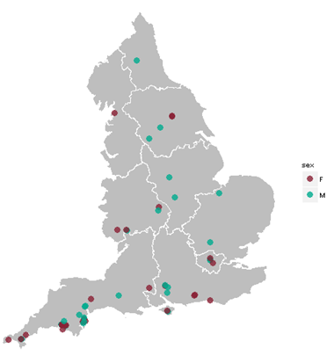
Example 2: case map with shape files
Map outbreak cases
Shape files: coordinates for polygons that define specific areas or regions
Overlay points on specific geographic areas (e.g. health regions)
Limit the map to a specific geographic area (region or country)

Slide 16
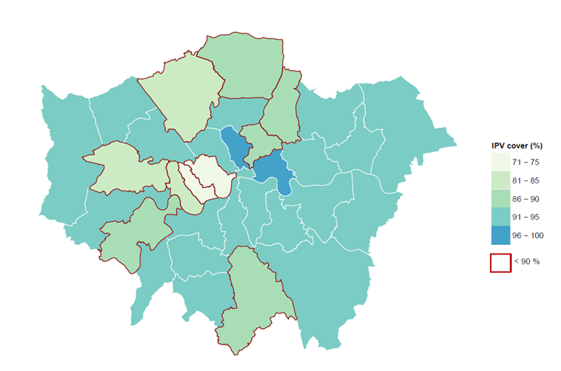
Example 3: choropleth map of incidence
Polio vaccination (IPV) coverage in infants aged 12 months, London, UK 2014

Slide 17
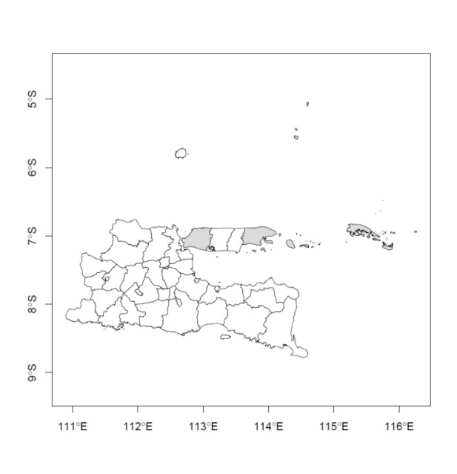
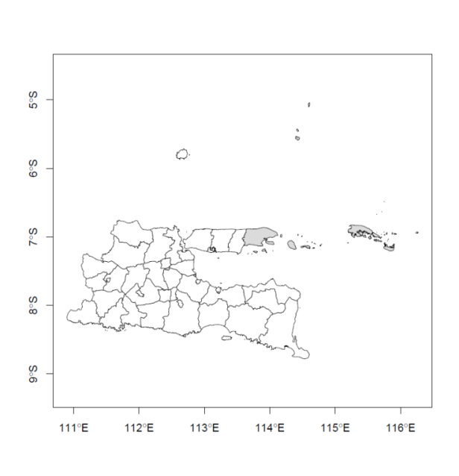
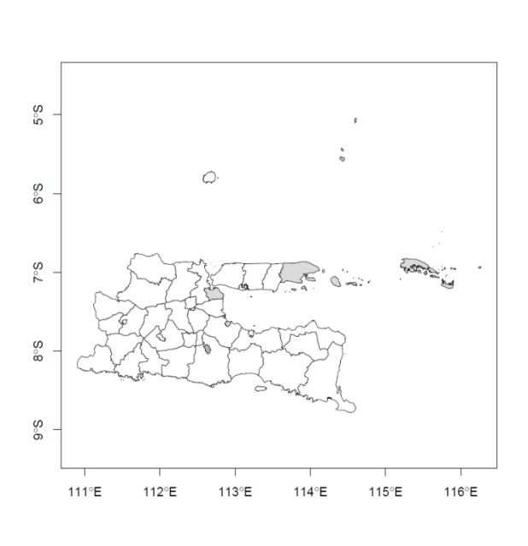
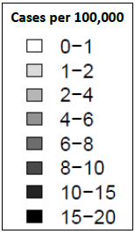
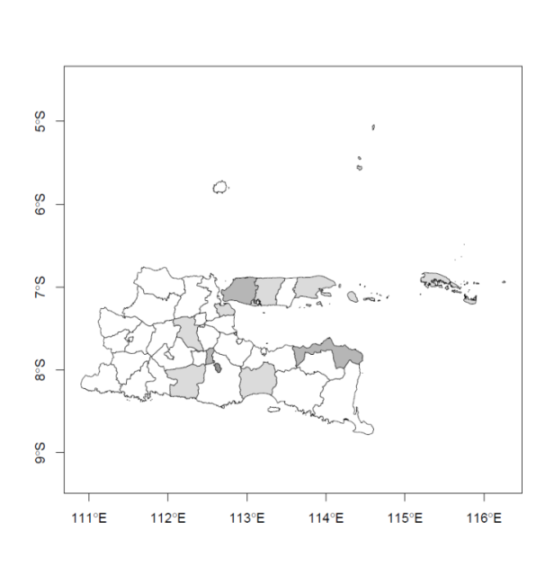
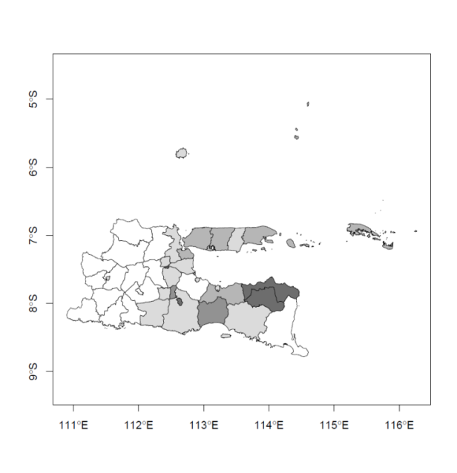
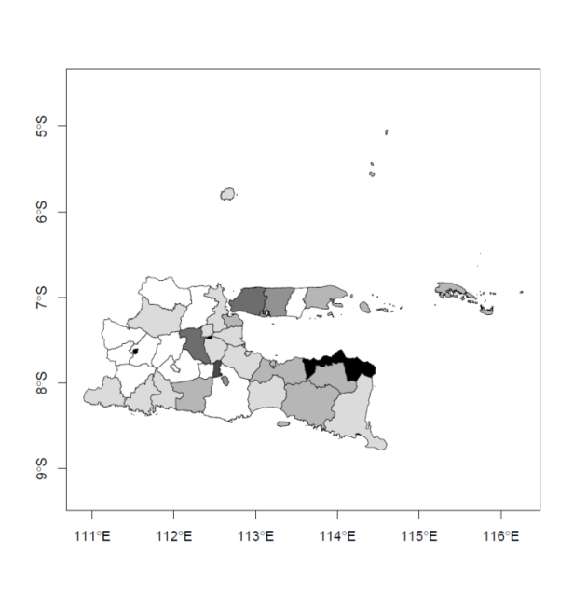
Example 4: map of case distribution over time
2007
2008
2009
2010
2011
2012
Diphtheria incidence per 100,000 population in East Java, Indonesia, 2007 - 2012

Slide 18
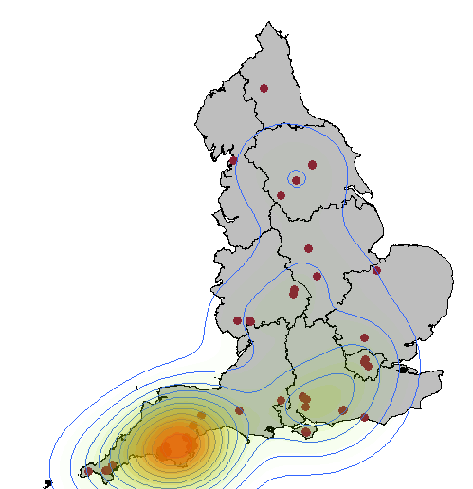
Example 5: contour map with hot-spots

Slide 19
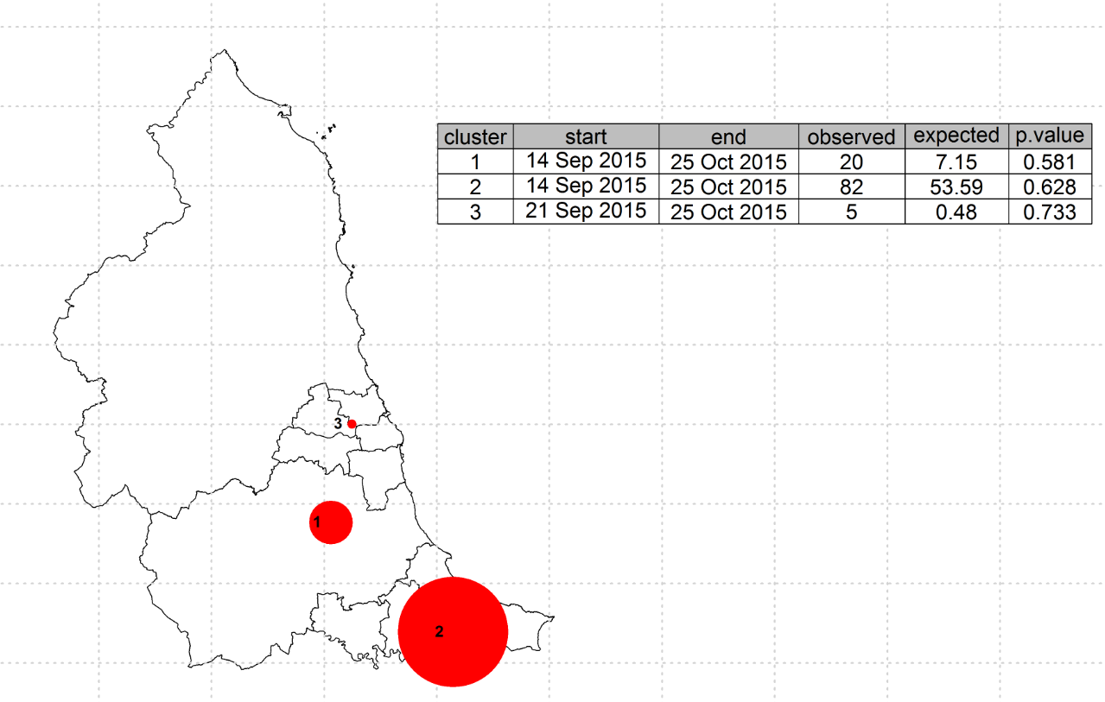
Example 6: map with spatial statistics (Satscan)
Notes:
This map is created by integrating with Satscan, the red circle showing possible clusters of cases (the radius of each circle represents the geographic radius of the cluster) that are too densely clustered to have arisen by chance.
Temporospatial analysis can also be performed.
There is an R package, rsatscan, which links with Satscan in order to provide similar analysis capabilities.

Slide 20
Mapping in R: case study
Introduction

Slide 21
R mapping case study: materials
Software:
R version 4.2.0 or greater
RStudio 2021.09.1 build 372 or similar
R packages:
Data wrangling: here, tidyverse, ggplot2, htmlwidgets
Mapping: tidygeocoder, ggmap, sf, osmdata, scales, leaflet
Data:
CaseStudy_RDM_anon_data_coords.csv (outbreak case line list)
PHEC_population.csv (population for health regions)
En_PHE_Centre.shp (shape files for health regions)

Slide 22
R mapping case study: folder structure
All material is provided in the Case study pack:
data folder (contains three raw data files)
guide folder (contains this presentation and the html practical guide for this session)
shapefiles folder (contains shape files for health regions in England)
In addition the following are provided in the root of the Mapping folder:
.here
Mapping.RPROJ
Mapping_R_template.RMD

Slide 23
R mapping case study: getting started
Save the Mapping folder somewhere on your computer.
Open the Mapping folder and double click on Mapping.RPROJ (this will open RStudio)
In the guide sub-folder, open Mapping_R_guide.html (this will open in your browser)
From your RStudio console, go to:
Files tab
Click on Mapping_R_template.R to open it within Rstudio
Work through the html guide, modifying and adding to code in the R template file as you go.

Slide 24
R mapping case study: setting the scene
Initial notification of the outbreak:
Outbreak of Shiga toxin-producing Escherichia coli (STEC)
Serotype O157:H7, Phage type 21/28, stx 2a
5 cases identified in autumn 2014
All exposed to unpasteurised milk from a farm in South West England
Cattle from the farm were infected with the same STEC strain
Subsequent information:
Case isolates belonged to a 5-SNP whole genome sequencing (WGS) cluster
4 further cases identified by WGS as also falling within this cluster
Wider phylogeny (25-SNP level) identified 59 linked cases in total
Unclear if these additional cases had the same exposure

Slide 25
R mapping case study: geospatial investigation
Because of the uncertainty around exposures for the additionally identified cases, you have been asked to investigate the spatial distribution of these cases, specifically:
Are pre-2014 cases also clustered near the farm in the South West?
Are all cases from the outbreak year (2014) clustered near the farm in the South West?
If not, does their spatial distribution pattern indicate an alternative source for this strain of STEC?
Are phylogenetically linked cases from other outbreaks also linked to the South West region?

Slide 26
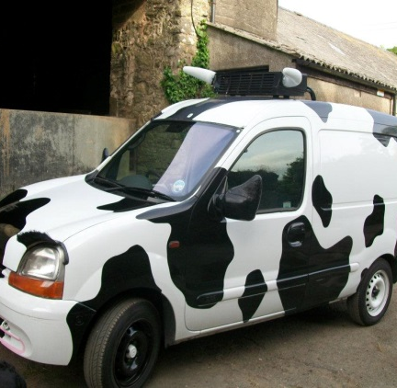
Mapping in R: case study
Conclusions

Slide 27
Mapping in R: case study conclusions
Further investigations revealed that some cases with no travel history to the South West of England, had bought raw milk from the farm via a mobile van, which made deliveries over a wide area.
Despite an initially dispersed pattern of distribution, corrections for case and population density revealed significant geospatial clustering in the South West region, with a hot-spot around the implicated farm.
Looking at the geographic dispersal of cases over time revealed that the outbreak strain had been circulating in this area for some years prior to notification of this event.
Public health measures were implemented to address the risk posed by raw drinking milk in the area and more widely across England.

Slide 28
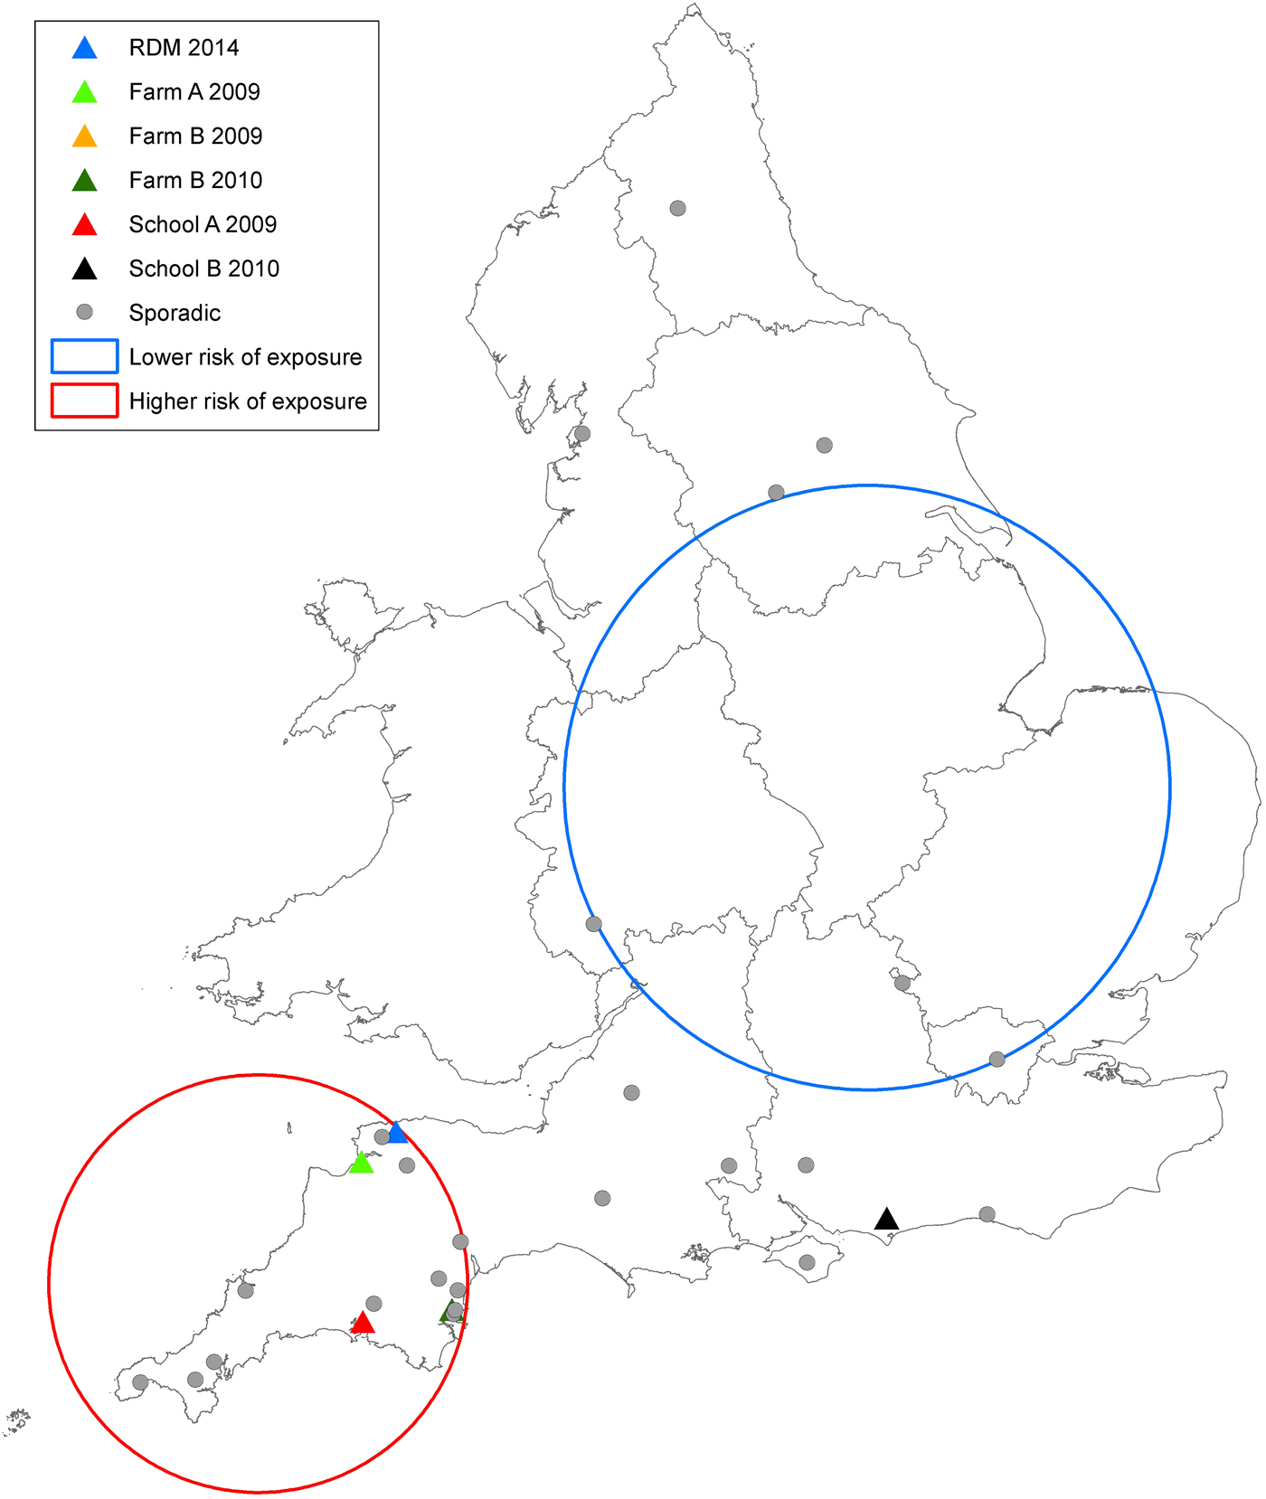
Mapping in R: case study conclusions
Fig. 4. Map showing the single point of exposure for cases falling within the outbreak cluster between 2009 and 2015. RDM, Raw cows' drinking milk.
Reference:
Butcher H, Elson R, Chattaway MA, Featherstone CA, Willis C, Jorgensen F, Dallman T, Jenkins C, McLauchlin J, Beck C, & Harrison S (2016). Whole genome sequencing improved case ascertainment in an outbreak of Shiga toxin-producing Escherichia coli O157 associated with raw drinking milk. Epidemiology and Infection, 144(13), 2812-2823.
https://doi.org/10.1017/S0950268816000509

